Slide 1

Lecture 07: Digital System Design
Dept. of Computer Sc. and Engg.
University of Rajshahi
www.ru.ac.bd
Dr. Mahboob Qaosar

Slide 2
Registers
Group of storage elements read/written as a unit.
Store related values (e.g. a binary word)
Collection of flip-flops with common control
Share clock, reset, set lines
Applications:
Storage registers
Frequency division
Shift registers
Counters

Slide 3
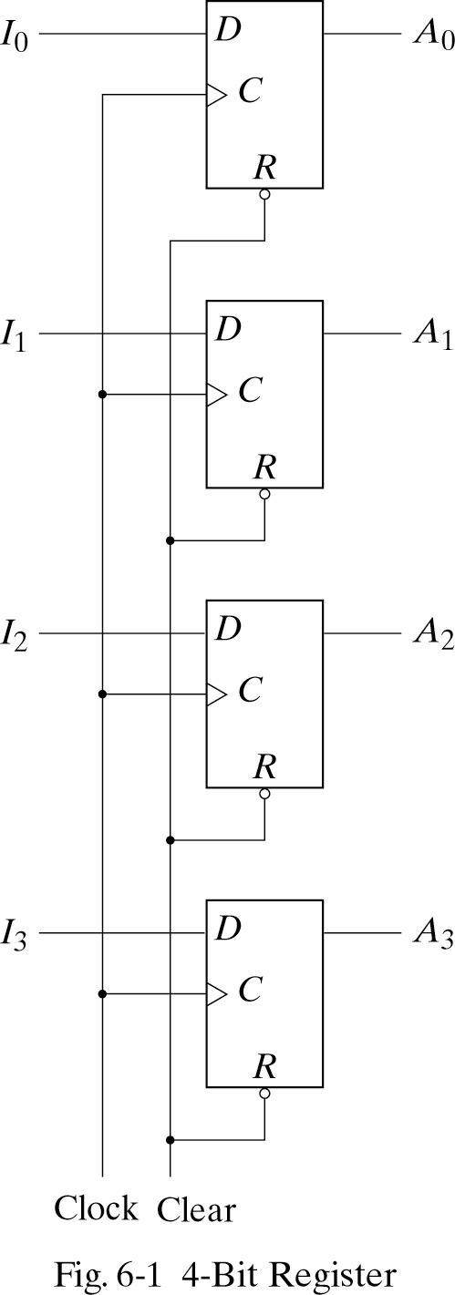
4-bit Storage Registers

Slide 4
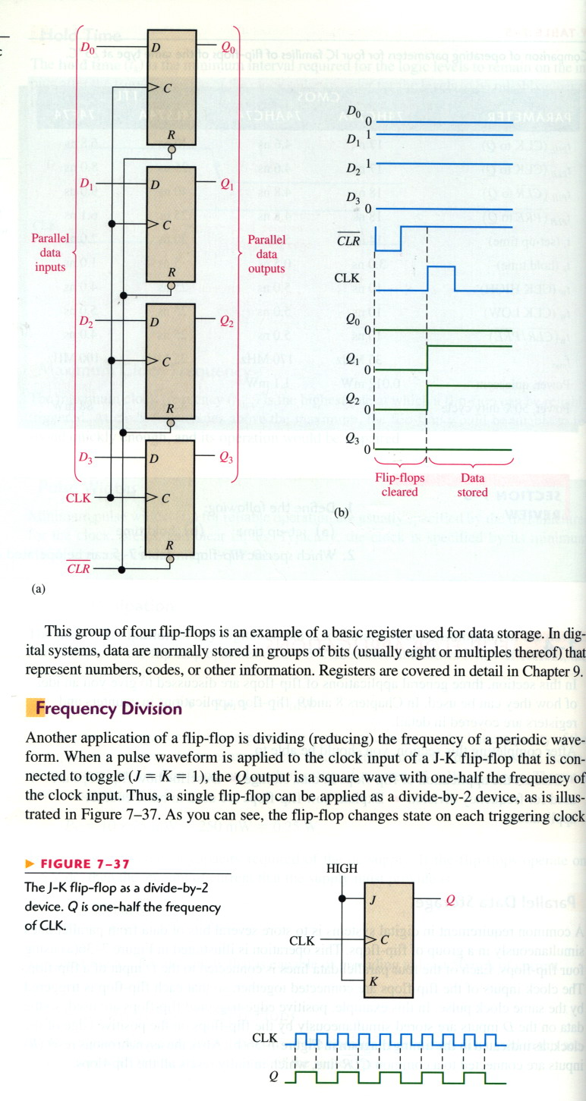
Frequency division

Slide 5
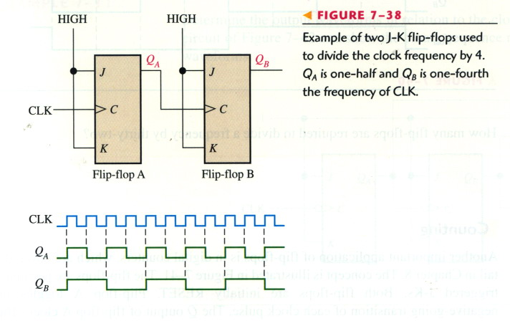
Frequency division

Slide 6
Register with Parallel load
If all bits of the register are loaded simultaneously with a common clock pulse, we say that the loading is done in parallel
When we want some registers remain unchanged (even with clock changes) we can use a load control input (see the next slide)
The load input determines whether the next pulse will accept new information or leave the information in the register intact.

Slide 7
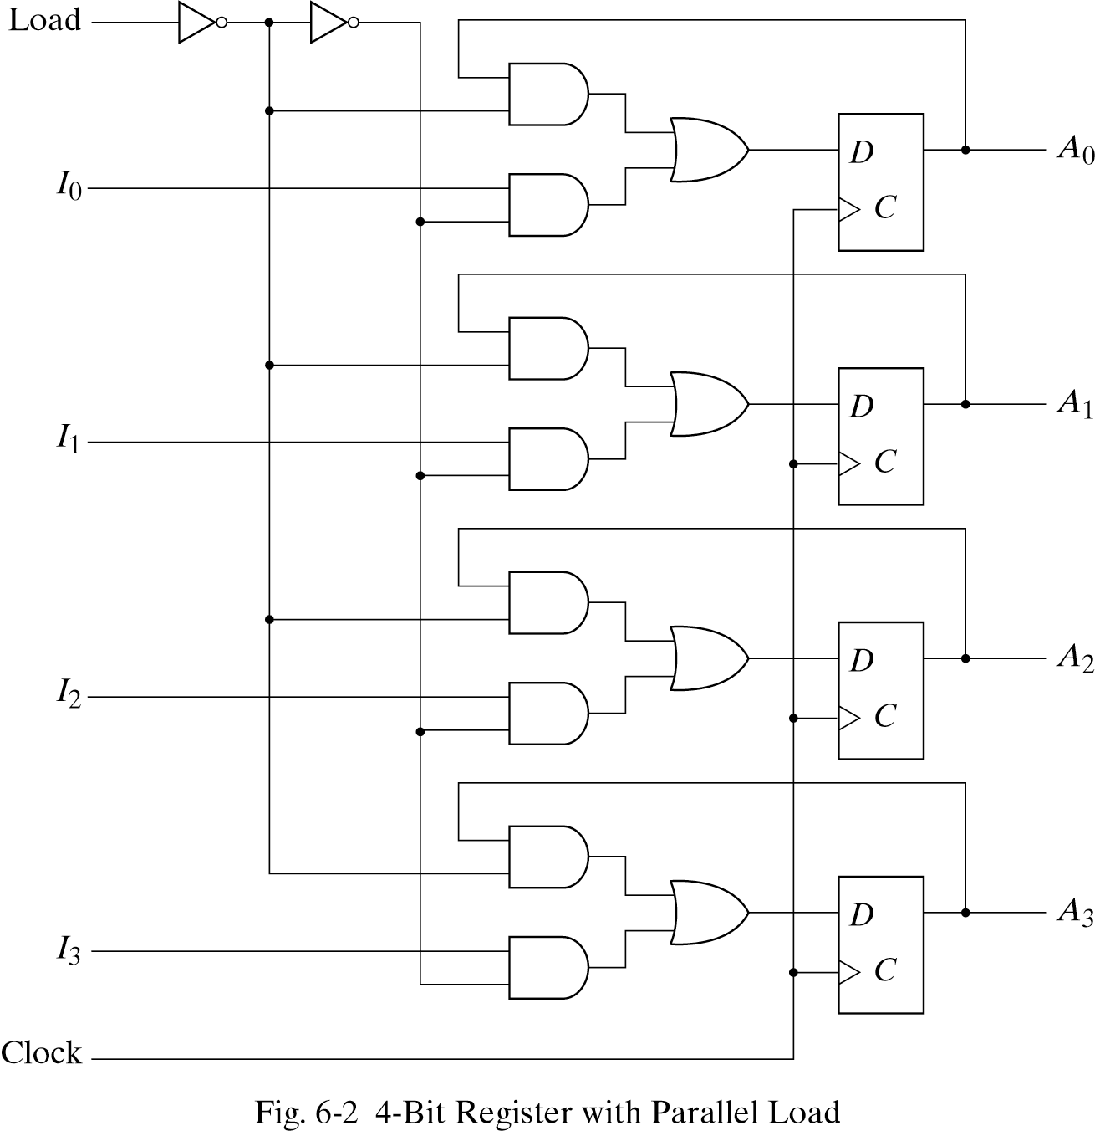

Slide 8
Shift Register
A register capable of shifting its binary information in one or both directions is called a shift register
For example by connecting the output of each D flip-flop to the input of another D flip flop in its right, each clock pulse shifts the content of the register one bit position to the right. The serial input determines what goes into the leftmost flip flop during the shift. The serial output is taken from the output of the rightmost flip flop.

Slide 9
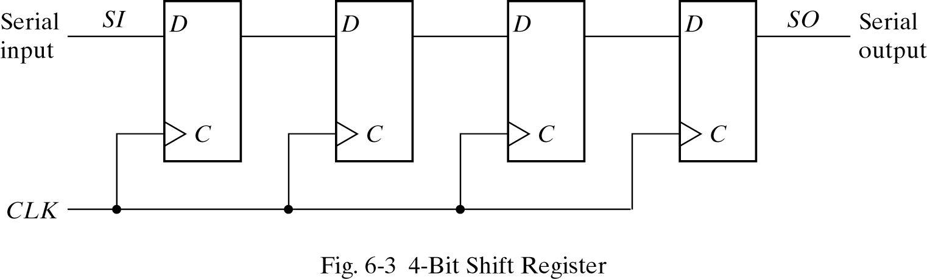

Slide 10
Shift-register applications
Parallel-to-serial conversion for signal transmission
Pattern recognition (circuit recognizes 1001)
serial transmission
parallel outputs
CLK
CLK
parallel inputs
OUT
IN
D
Q
D
Q
D
Q
D
Q
CLK

Slide 11
Various Shift Registers
Serial in/serial out shift registers
Serial in/parallel out shift registers
Parallel in/serial out shift registers
Parallel in/parallel out shift registers
Bidirectional shift registers

Slide 12
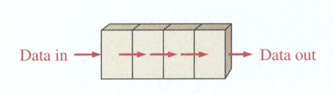
Serial in/serial out shift registers
It accepts data serially, one bit at a time on a single line, and produces the sorted information on its output also in a serial form

Slide 13
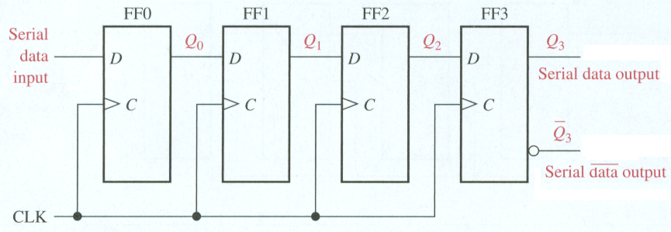
Serial in/serial out shift registers
4 bit register
It needs 4 clock pulses to store 4 bits
Example:
Illustrate entry of the 4 bits 1010 into the register.
Illustrate serially shifting the 4 bits out of the register, i.e. clearing the register.

Slide 14
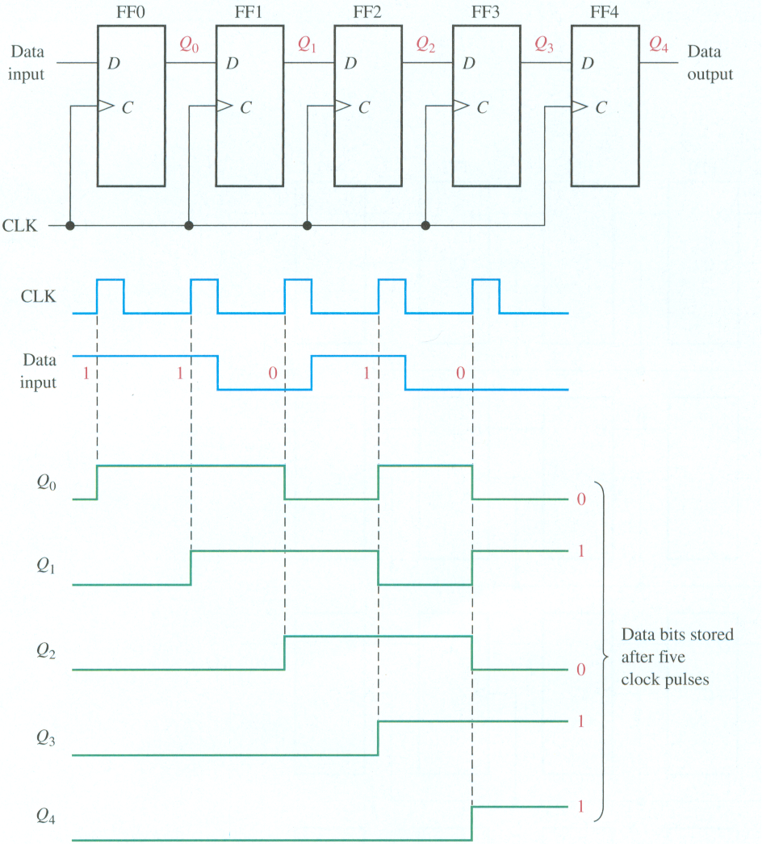
Example: Show the states of the 5-bit shift register for the specified data input and clock waveforms. The registered is initially cleared.

Slide 15
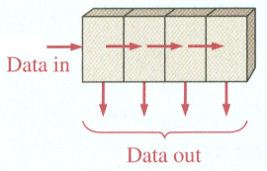
Serial in/parallel out shift registers
Data bits are entered serially as illustrated before
Once the data are stored, the output of each stage is available on its output line.

Slide 16
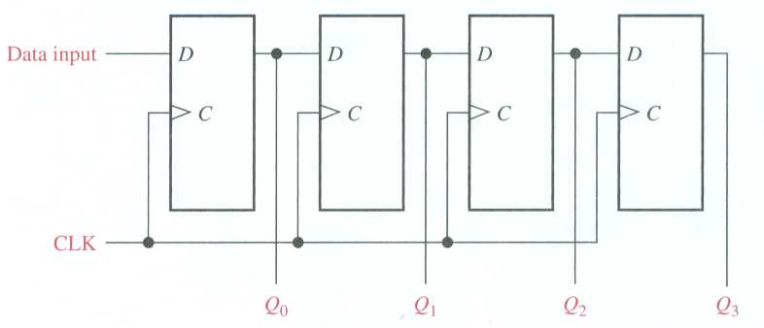
Serial in/parallel out shift registers
4-bit register

Slide 17
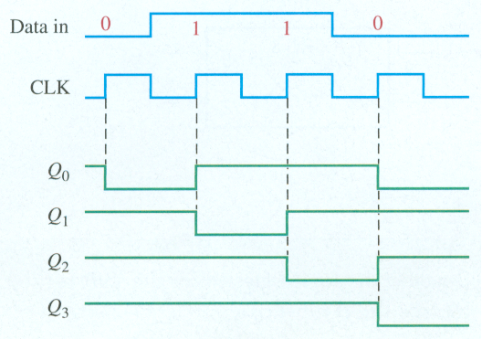
Serial in/parallel out shift registers
Example: Show the state of the 4-bit register foe the data input and clock waveforms. The register initially contains all 1s.

Slide 18
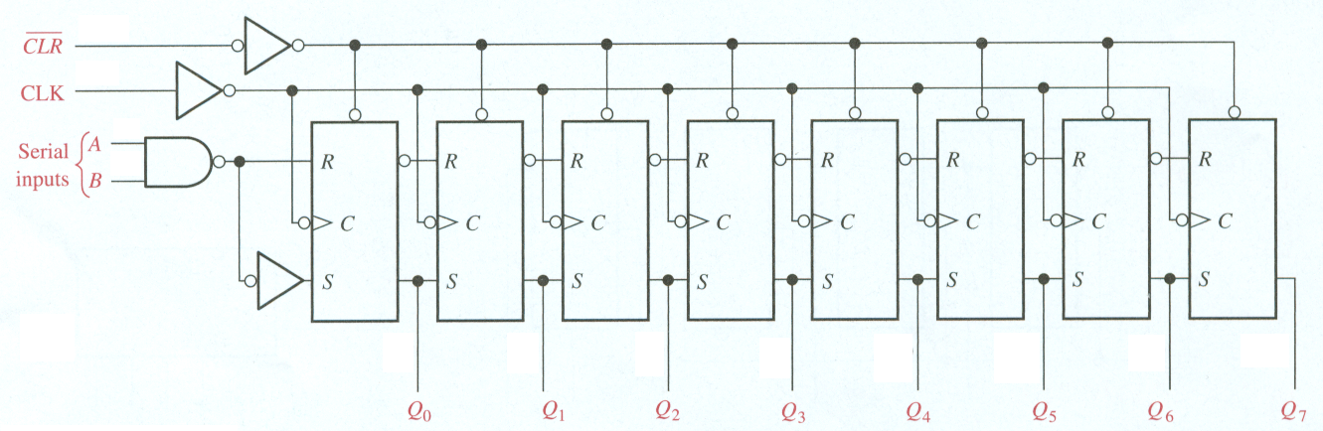
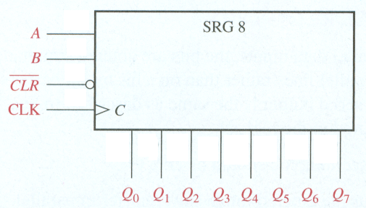
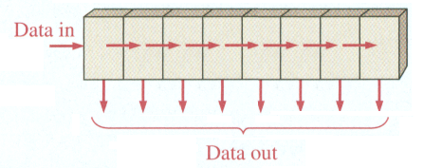
Serial In/Parallel Out Shift Registers
8-bit serial in/parallel out

Slide 19
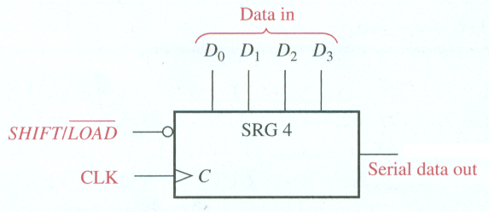
Parallel In/Serial Out Shift Registers
The bits are entered simultaneously into their respective stages.
The serial output appears bit by bit per clock pulse.
To store 4 bits, we need 1 clock pulse
To shift them out them, we need another 3 clock pulses.
4-bit parallel in/serial out

Slide 20
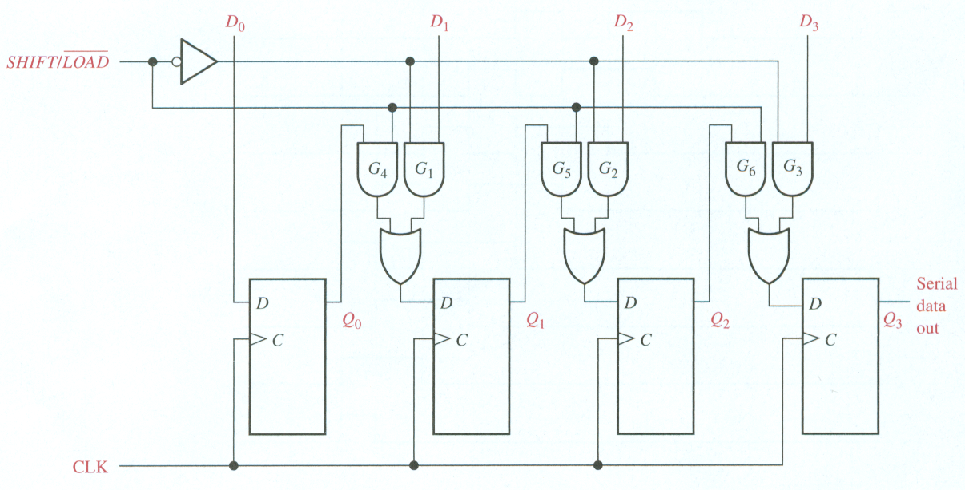
Parallel In/Serial Out Shift Registers
4-bit parallel in/serial out

Slide 21
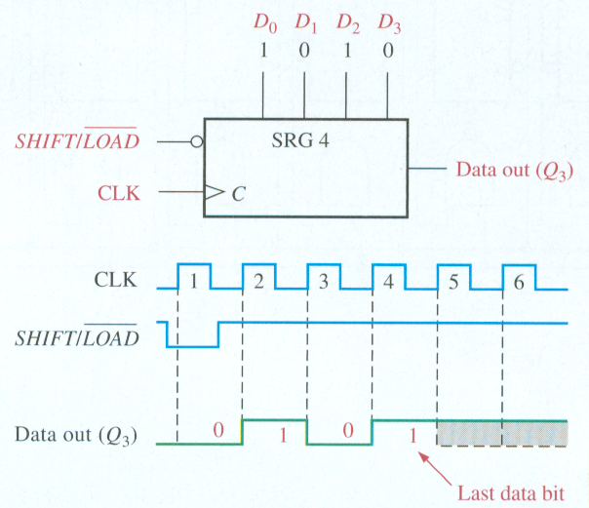
4-bit parallel in/serial out

Slide 22
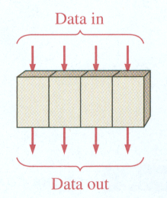
Parallel In/Parallel Out Shift Registers
The bits are entered simultaneously into their respective stages.
Immediately, the bits appear on the parallel outputs.
4-bit version

Slide 23
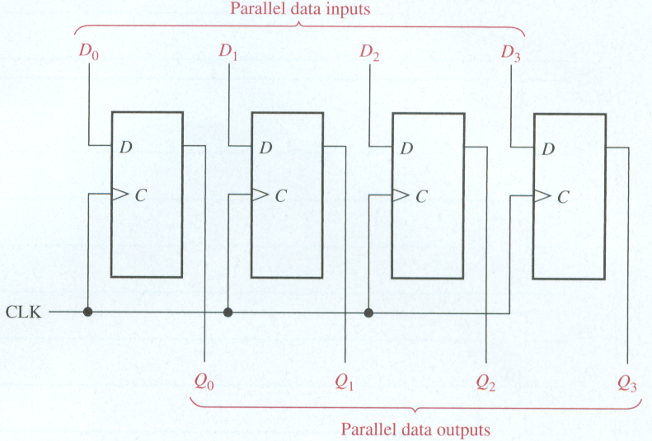
Parallel In/Parallel Out Shift Registers
4-bit version

Slide 24
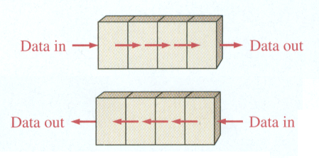
Bidirectional Shift Register
A bidirectional shift register is one in which the data can be shifted either left or right.
4-bit version

Slide 25
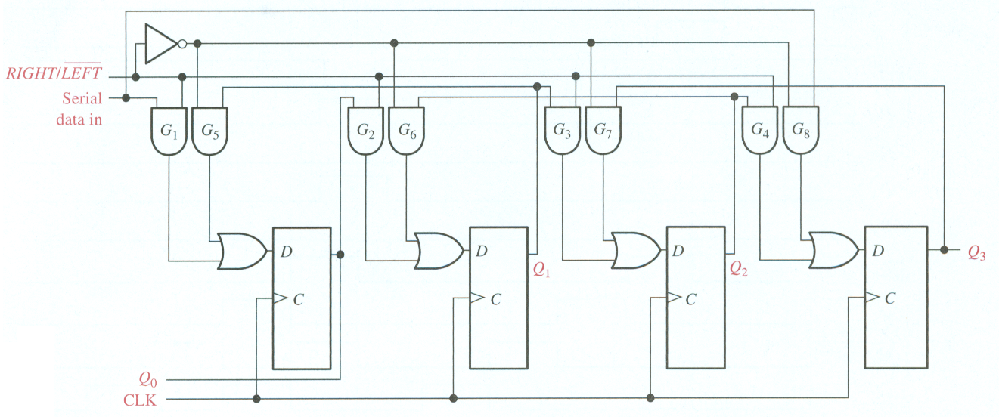
Bidirectional 4-bit Shift Register

Slide 26
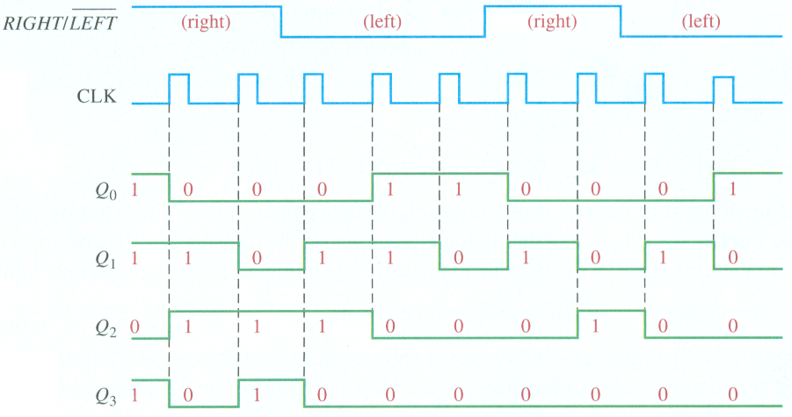
Bidirectional 4-bit Shift Register

Slide 27
Counters
A counter is a register that goes through a predetermined sequence of states upon the application of clock pulses.
A counter that follows the binary number sequence is called a binary counter.
Counters are categorized as:
Asynchronous/Ripple Counters: The FF output transition serves as a source for triggering other FFs. No common clock.
Synchronous Counter: All FFs receive the common clock pulse, and the change of state is determined from the present state.

Slide 28
Asynchronous/ Ripple Counter
Only the first flip-flop is clocked by an external clock. All subsequent flip-flops are clocked by the output of the preceding flip-flop.
Asynchronous counters are slower than synchronous counters because of the delay in the transmission of the pulses from flip-flop to flip-flop.
Asynchronous counters are also called ripple-counters because of the way the clock pulse ripples it way through the flip-flops.

Slide 29
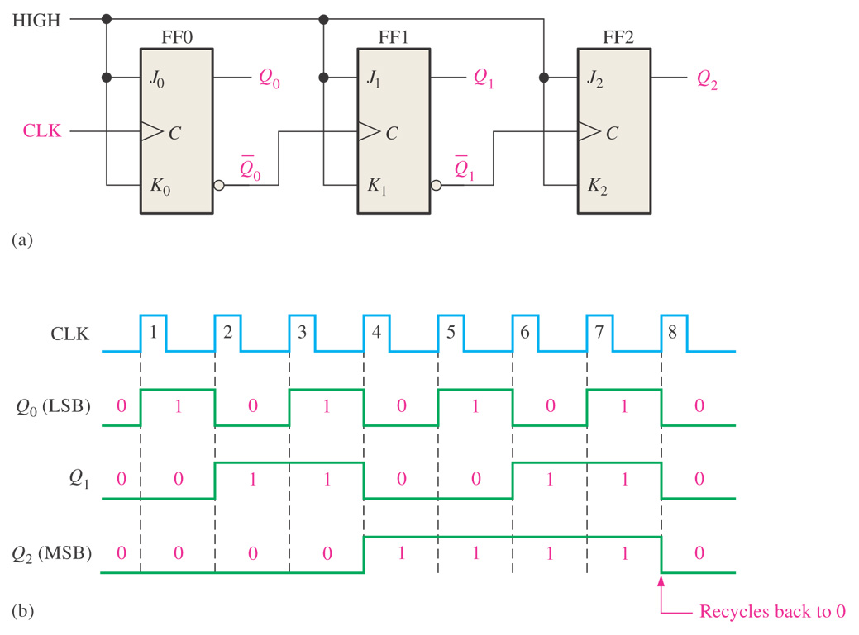
3-bit asynchronous binary counter and its timing diagram for one cycle.

Slide 30
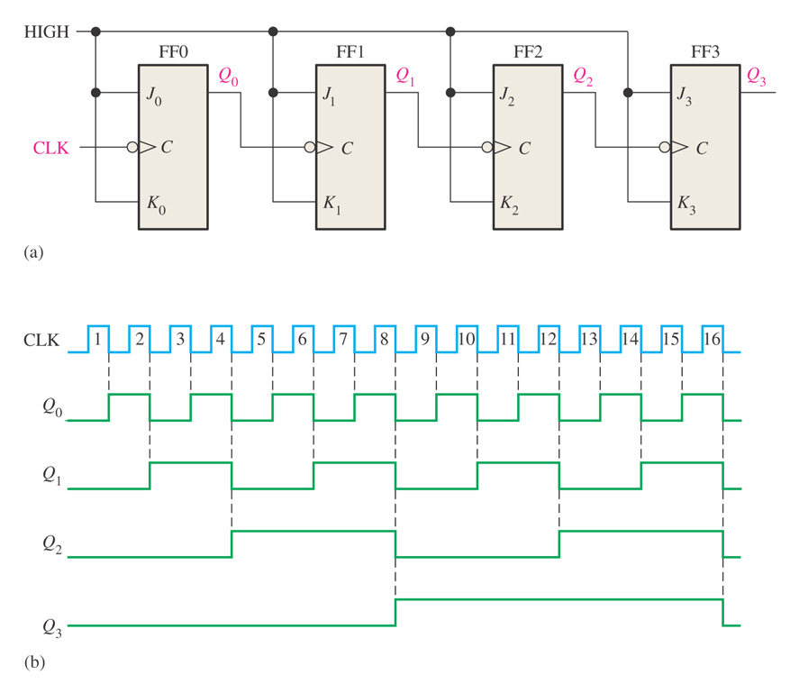
Four-bit asynchronous binary counter and its timing
diagram.

Slide 31
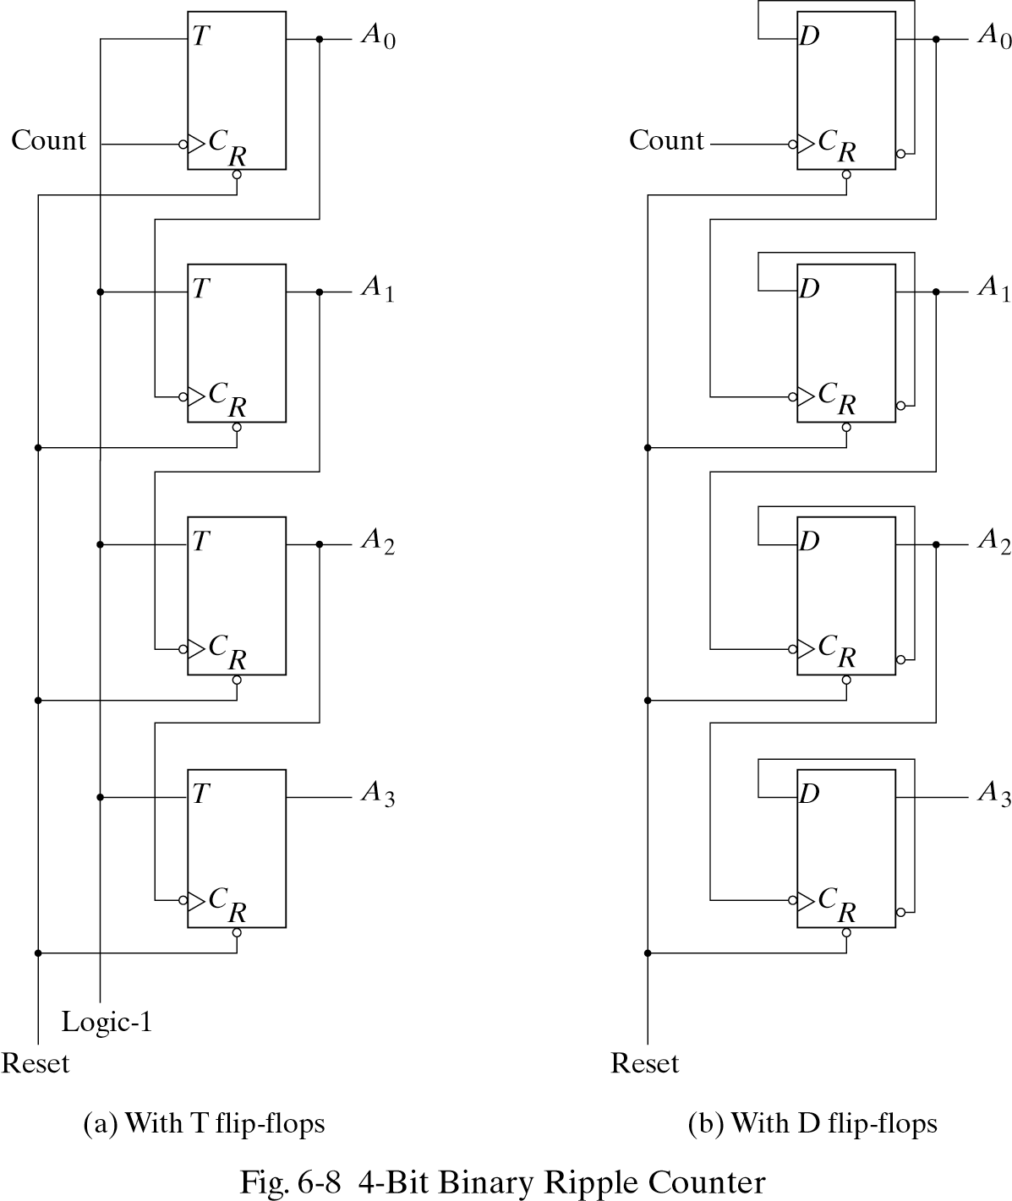

Slide 32
Asynchronous Decade Counters
These counters have 10 states in their sequence.
A decade counter of states from 0000 to 1001 is called a BCD decade counter.
Since the counter would have 16 states, it is forces to recycle before going through all of its possible state.
The BCD decade counter is recycled to 0000 after the 1001 state.
This is done as shown in the next slide by decoding count 1010 with an NAND gate and
connecting the output of the NAND gate to the clear inputs of the flip-flops.

Slide 33
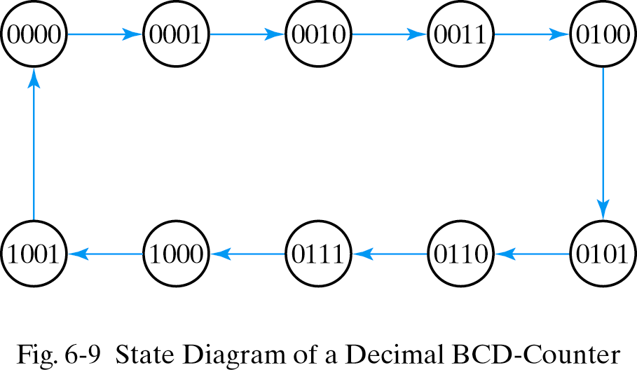

Slide 34
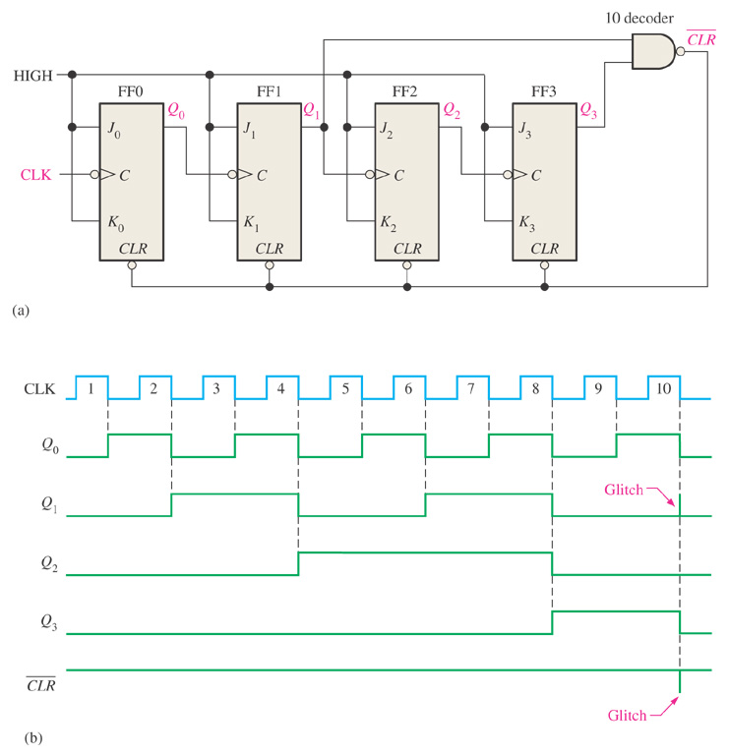
An asynchronously clocked decade counter with asynchronous recycling.

Slide 35
End

